Slide 1

Electricity Demand Forecasting
Course – Time Series Analysis
CHETAN JAIN – E23CSEU1227
CHINMAY PAL – E23CSEU1204

Slide 2

INTRODUCTION
Electricity demand forecasting is a critical application of time series analysis in the energy sector. It involves analyzing historical electricity consumption data to understand patterns such as trends, seasonality, and fluctuations over time. Time series analysis helps in identifying Trend, Seasonality, Cyclic patterns and Irregular variations
This analysis is widely used in energy management, smart grids, and power system planning to ensure efficient electricity distribution and avoid shortages or wastage.
• Application Domain:
Energy Management and Power System Planning
• Scope of the Project:
Power companies, grid operators, and energy planners can use this forecasting to manage electricity supply and demand effectively

Slide 3
PROBLEM STATEMENT
Electricity demand varies significantly over time due to factors such as weather conditions, population growth, industrial usage, and seasonal changes. Inaccurate demand estimation can lead to power outages or overproduction.
Motivation:
Growing energy consumption worldwide
Need for efficient energy management
Avoiding power shortages and blackouts
Supporting renewable energy integration
This project aims to analyze electricity demand data to understand patterns and prepare for accurate forecasting in future stages.

Slide 4
DATASET DESCRIPTION
Dataset Name = Open Power System Data (Time Series Electricity Dataset)
Source = Open Power System Data (OPSD)
Nature of Data: Contains electricity consumption recorded over time (e.g., hourly/daily usage)
Time index = utc_timestamp
Frequency = Hourly/Daily Data
Number of records = ~350,000+ (depends on file version)
Key Variables: Date/Time , Electricity Demand
File Format: CSV
Data Quality Notes:
  > Some missing values may exist
  > Possible outliers during peak usage

Slide 5
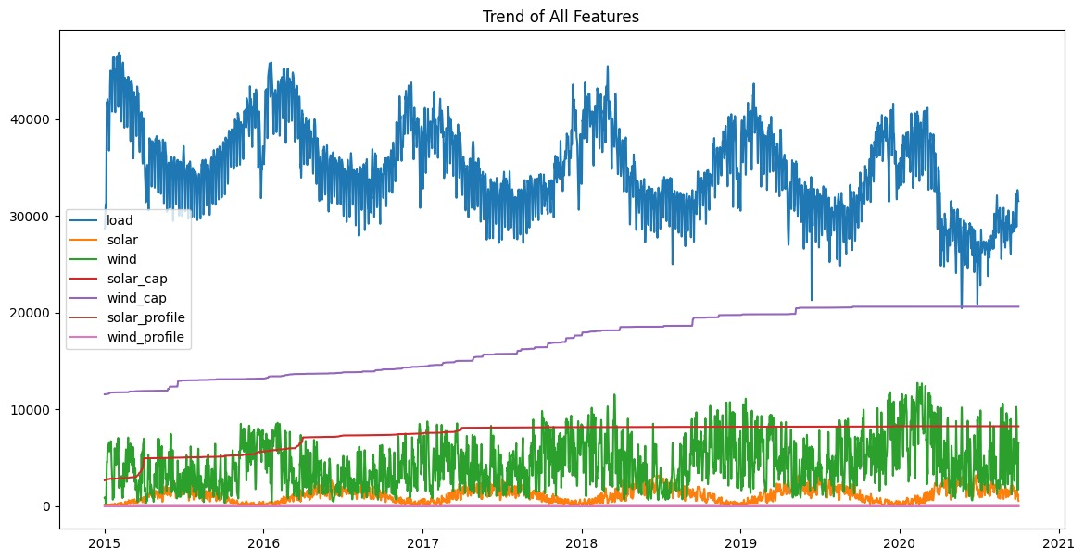
Long-Term Trends (2015-2021)
This graph isolates the long-term trend component of our dataset over a six-year period, removing the daily and seasonal noise to show the underlying trajectory of the grid.

Slide 6
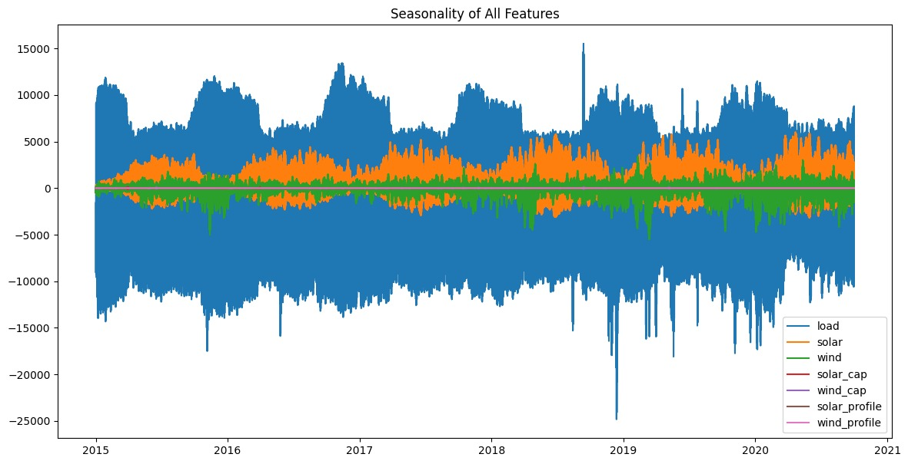
Highly Seasonal Patterns
This graph extracts just the seasonal component of our features, centered around zero.

Slide 7
PROJECT OBJECTIVES
To perform exploratory data analysis on electricity demand data
To identify trends and seasonal patterns
To detect missing values and anomalies
To define the scope for future forecasting models
To apply forecasting models like ARIMA/SARIMA and LSTM
To evaluate model performance using error metrics

Slide 8
PROPOSED METHODOLOGY
Data collection and preprocessing
Time series visualization (line plot, seasonal plot)
Identification of trend and seasonality
Handling missing values
Future Models:
> ARIMA / SARIMA
> Holt-Winters
> LSTM / XGBoost / Prophet

Slide 9
CONCLUSION
Electricity demand forecasting plays a vital role in efficient energy management and planning. This project focuses on analyzing time series data to uncover patterns and insights that can support better decision-making. Some challenges include handling missing data, dealing with non-stationarity, and identifying complex seasonal patterns.
In future phases, forecasting models will be implemented and evaluated to improve prediction accuracy and provide actionable insights.
References: Data Open Power System(dataset)

